Slide 1
Data Management Planning
(adapted from DataONE training materials)

Slide 2

Topics
What is a data management plan (DMP)?
Why prepare a DMP?
Components of a DMP
NSF requirements for DMP
Example NSF DMP
Data management plans

Slide 3

What is a DMP?
Outlines what you will do with your data during your research project and after you complete your research
Ensures your data is safe for the present and the future
From University of Virginia Library
Data management plans

Slide 4
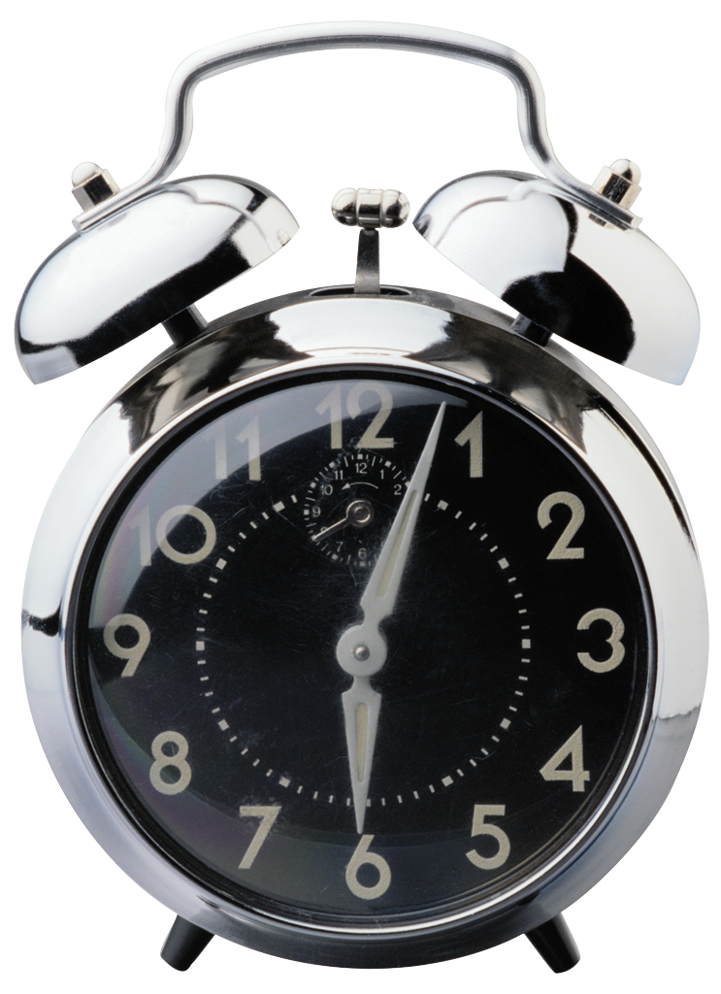
Why Prepare a DMP?
Save time
Less reorganization later
Increase research efficiency
Ensures you and others will be able to understand and use data in future
Funding agency requirement
Data management plans
Notes:
Save time
if organization scheme is decided on early, it can be used throughout the life of the data rather than having to organize after data have been collected
Allows focus on research
Increases research efficiency: if data are documented well before and during data collection, it prevents problems in understanding data and metadata in the future, by both you and others

Slide 5

NSF DMP Requirements
From Grant Proposal Guidelines:
Plans for data management and sharing of the products of research. Proposals must include a supplementary document of no more than two pages labeled “Data Management Plan”. This supplement should describe how the proposal will conform to NSF policy on the dissemination and sharing of research results (in AAG), and may include:
the types of data, samples, physical collections, software, curriculum materials, and other materials to be produced in the course of the project
the standards to be used for data and metadata format and content (where existing standards are absent or deemed inadequate, this should be documented along with any proposed solutions or remedies)
policies for access and sharing including provisions for appropriate protection of privacy, confidentiality, security, intellectual property, or other rights or requirements
policies and provisions for re-use, re-distribution, and the production of derivatives
plans for archiving data, samples, and other research products, and for preservation of access to them
Data management plans
Notes:
As of January 2011 NSF is now requiring 2 page data management plan to be included in all submitted proposals. This is in addition to the 15 pages for the proposal.
AAG = award and administraition guide; see next slide

Slide 6
History
NSF has had a data sharing policy in place for many years, in compliance with the 1999 Office of Management and Budget’s (OMB) Circular A-110 which requires that data generated from federally funded research be made publicly available via the process instituted by the Freedom of Information Act.
A more recent development is the 2009 Open Government Initiative, charging federal agencies to take a committed stance toward effecting transparency, participation, and collaboration in their activities.
LTER has required data sharing since 1980.

Slide 7
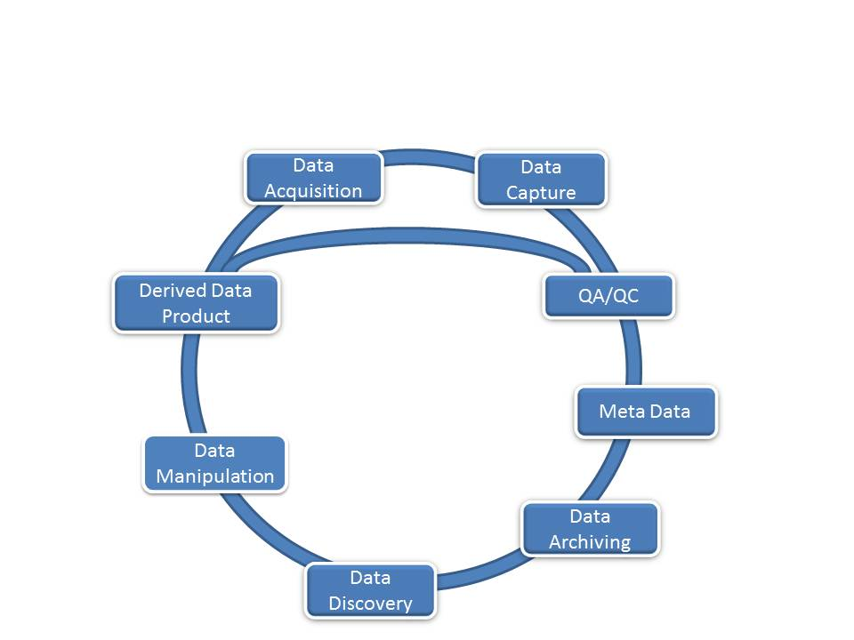
What should be included in a Data Management Plan?

Slide 8
Components of a DMP
Information about data & data format
Metadata content and format
Policies for access, sharing and re-use
Long-term storage and data management
Budget
Components of a DMP
Notes:
These are the five main categories of information that should be included in any DMP. Slides that follow will go into more detail for each

Slide 9

1. Information About Data & Data Format
1.1 Description of data to be produced
Experimental
Observational
Raw or derived
Physical collections
Models
Simulations
Curriculum materials
Software
Images
Etc…
Components of a DMP
Notes:
There are many different types of data that may be produced by a research study. Consider this list when describing data that will be produced by the project

Slide 10

1. Information About Data & Data Format
1.2 How data will be acquired
When?
Where?
1.3 How data will be processed
Software used
Algorithms
Workflows
Components of a DMP
Notes:
Describe how the data will be obtained. Include the who, what, when, where of collection
Data processing is important to consider before the project since it may affect how data are organized, what formats are used, and what hardware/software should be budgeted for
Workflows are process metadata- descriptions about how the data will be manipulated/processed/changed during analyses

Slide 11

1. Information About Data & Data Format
1.4 File formats
Non-proprietary format desirable
Naming conventions
1.5 Quality assurance & control during sample collection, analysis, and processing
Components of a DMP
Notes:
File formats
File formats should be determined ahead of time. Consider using non-proprietary software formats.
When saving files for the long term, it’s best to use standard formats such as .csv or .txt
Whatever format is chosen, justify your choice. Consider what standards are commonly used in your scientific discipline
Describe the naming conventions that will be used for the file. By determining these ahead of time, you are less likely to need to go through and change/reorganize files during or after the project
QA/QC
Describe what measures will be taken to ensure data are high quality
Consider what will be done during data collection
Double entry of data into spreadsheets by two people is always wise
Identify any steps that you might take during analysis and processing to eliminate “bad” data points (not outliers, but rather errors)

Slide 12

1. Information About Data & Data Format
1.6 Existing data
If existing data are used, what are its origins?
Will your data be combined with existing data?
What is the relationship between your data and existing data?
1.7 How data will be managed in short-term
Version control
Backing up
Security & protection – who has access?
Who will be responsible
Components of a DMP
Notes:
Existing data
How will your project relate to existing data?
Describe the origins of existing data that you might use during your process (e.g. meta-analysis projects)
If your data set is intended to be combined in the future with existing data, describe how you will ensure that formats are compatible
Describe the relationship between the data you are collecting and what’s already in existence
How data will be managed in the short term
Version control: keeping track of different versions of your data and/or analyses
There is version control software available for text-based data
Can include information about versions in file names
keep track of how versions differ (document file versions)
Backing up: consider on-site versus off-site. Are servers available at your institution?
Security/protection: are data sensitive? Who will have access?
Who will be responsible: Assign roles and responsibilities for data management/archiving/version control/backing up etc

Slide 13
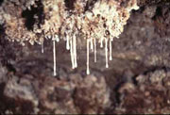
Cave Microbiology DMP: Data and Data Formats Example
“After each sampling trip, researchers will fill out a sample database template, which will be integrated into the main FileMaker Pro Sample Database.
Datasheets are created during each SEM session then entered in to the database.
Data will be converted to .csv files for archiving.”
Credit: Diana Northup

Slide 14




2. 2. Metadata Content & Format
2.1 What metadata are needed
Any details that make data meaningful
2.2 How metadata will be created and/or captured
Lab notebooks? GPS units? Auto-saved on instrument?
2.3 What format will be used for the metadata
Standards for community (EML, ISO 19115, etc.)
Justification for format chosen
Components of a DMP
Notes:
What metadata are needed
Identify ahead of time what metadata will be important to capture during the data collection and analysis phases
What format will be used for the data
There are many different metadata formats available. Ask colleagues about what is used by the majority of your discipline
Check with the repository you plan to use for data preservation- many have metadata format requirements. This saves time in the long run
Justify the format you choose for your metadata- consider the community, the archive, and the nature of the project
The icons all represent different formats for metadata

Slide 15
Cave Microbiology DMP: Metadata example
“Metadata Standards: Standard archival metadata schema (Premis, Dublin Core, XFDU) will be used upon archiving. We will be using Darwin Core metadata schema (http://www.tdwg.org/) to document biological specimens.
We anticipate using the Open Microscopy Environment Metadata Standard (OME-XML, http://www.ome-xml.org/) to document our SEM images.”

Slide 16

3. Policies for Access, Sharing, Reuse
3.1 Obligations for sharing
Funding agency
Institution
3.2 Details of data sharing
How long?
When?
How access can be gained?
3.2 Ethical/privacy issues with data sharing
Components of a DMP
Notes:
Obligations for sharing
Describe any requirements you might have for sharing as a result of your funding, your institution, your professional society, etc.
Consider any legal obligations for sharing data.
Check with your institution- they often have information available for researchers regarding sharing obligations within and beyond the institution
Details of sharing:
How long will the data be available?
When will that access be granted?
Who will have access to those data? How will they gain access?
Will the data collector/creator/PI have exclusive rights to data for a certain period of time?
Ethical/privacy:
- are data about humans? If so, address human subjects research protocols.
Other example of ethical/privacy concerns: locations of sensitive habitats or organisms
Informed consent issues
How privacy will be protected; participant confidentiality arrangements

Slide 17

3. Policies for Access, Sharing, Reuse
3.4 Intellectual property & copyright issues
Who owns the copyright?
Institutional policies
Funding agency policies
Embargos for political/commercial reasons
3.5 Intended future uses/users for data
3.6 Citation
How should data be cited when used?
Persistent citation?
--Digital Object Identifier (DOI)
Components of a DMP
Notes:
IP/copyright:
Institutions and/or funding agencies often have a policy for this
Address any embargos on data due to patents, politics etc.
Intended future uses/users
- Helps determine good data archive to use
By thinking about this at planning stages, can prepare data better for future use/users
Citation
How should dataset be cited
How authors should be credited
Consult policies and options with data archive you will be using
Persistent citation = will not change over time. Consider DOIs

Slide 18
LTER Policy:
LTER Network Data Release Policy
Data and information derived from publicly funded research in the U.S. LTER Network, totally or partially from LTER funds from NSF, Institutional Cost-Share, or Partner Agency or Institution where a formal memorandum of understanding with LTER has been established, are made available online with as few restrictions as possible, on a nondiscriminatory basis. LTER Network scientists should make every effort to release data in a timely fashion and with attention to accurate and complete metadata.
Data
There are two data types:
Type I – data are to be released to the general public according to the terms of the general data use agreement (see Section 3 below) within 2 years from collection and no later than the publication of the main findings from the dataset and,
Type II - data are to be released to restricted audiences according to terms specified by the owners of the data. Type II data are considered to be exceptional and should be rare in occurrence. The justification for exceptions must be well documented and approved by the lead PI and Site Data Manager. Some examples of Type II data restrictions may include: locations of rare or endangered species, data that are covered under prior licensing or copyright (e.g., SPOT satellite data), or covered by the Human Subjects Act. Researchers that make use of Type II Data may be subject to additional restrictions to protect any applicable commercial or confidentiality interests.

Slide 19









4. Long-term Storage & Data Management
4.1 What data will be preserved
4.2 Where it will be preserved
Most appropriate archive for data
Community standards
Succession plans
4.3 Data transformations/formats needed
Consider archive policies
4.4 Who will be responsible
Contact person for archive
Components of a DMP
Notes:
Not all data should be preserved
Focus on raw data
Data derivatives can also be preserved but should be linked to raw data with workflows and/or in metadata
where it will be preserved
What archives are commonly used in your community
Archives last longer than lab/personal websites
Check to see if institution has repository available to researchers
Are there any organizations or societies that might house your data
Include succession plans if the expected place for archiving goes out of existence
Data transformations/formats: contact the data repository you will use early in the project to be sure you have data in correct format. Saves time later
Be sure there is a person assigned responsibility for maintaining contact information for the archive. This is especially important if restrictions on data use require that they contact the data collectors before reusing data

Slide 20

Ocean Science DMP (Storage Example)
“Basic oceanographic (salinity and temperature, chl a, DOC) and MET data obtained from the cruise will be archived in the NOAA PMEL database that is set up for our cruise (http://saga.pmel.noaa.gov/data_servers.html), as well as other appropriate data banks including the National Oceanographic Data Center (NODC) and the Biological and Chemical Oceanography Data Management Office (BCO-DMO; http://bco-dmo.org/), within six months after completion of our cruise.
Aerosol and bubble measurements will be described and made available at the Russell group
website at http://aerosols.ucsd.edu/.”
Credit: C.A. Linder, WHOI

Slide 21

5. Budget
5.1 Anticipated costs
Time for data preparation & documentation
Hardware/software for data preparation & documentation
Personnel
Archive costs
5.2 How costs will be paid
Components of a DMP
Notes:
Can request funds specifically for data management

Slide 22
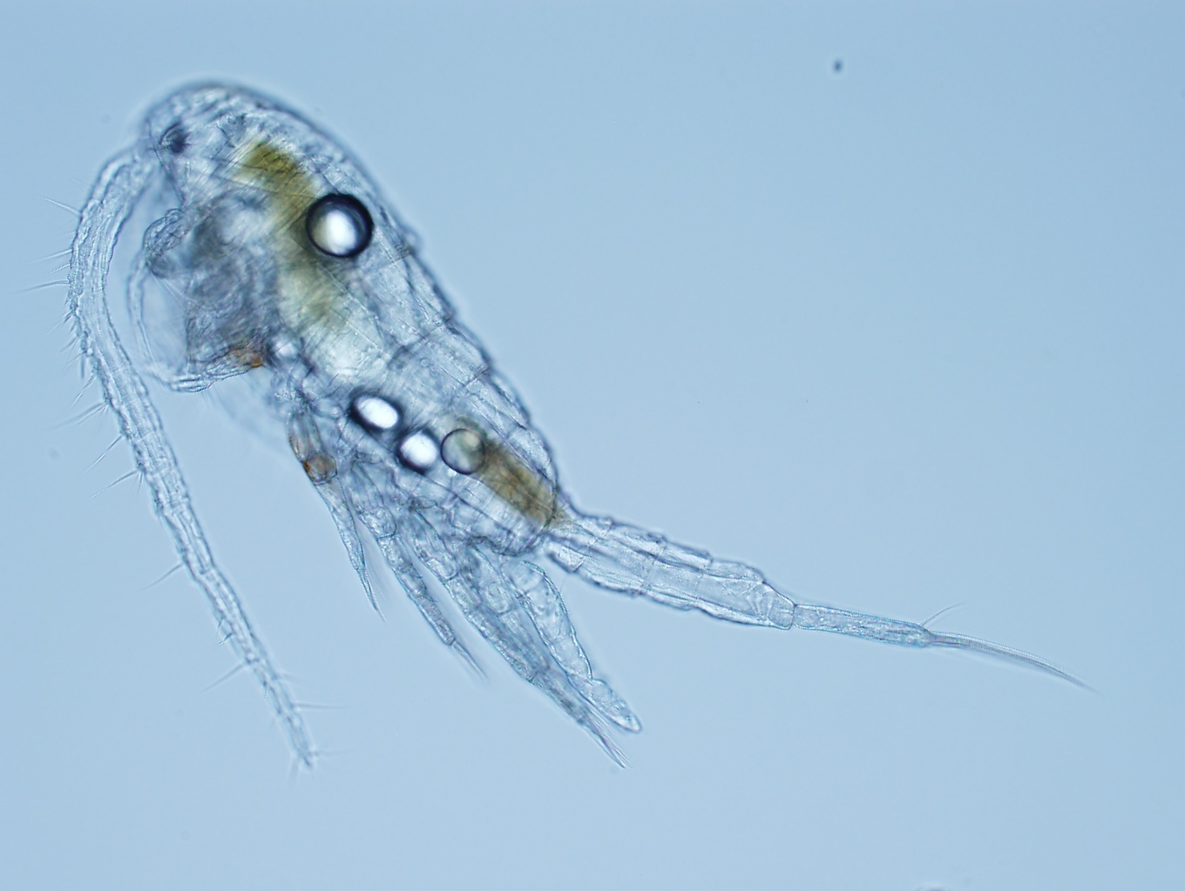
Example DMP: Background
Project name: Effects of temperature and salinity on population growth of the estuarine copepod, Eurytemora affinis
Project participants and affiliations:
Carly Strasser (University of Alberta and Dalhousie University)
Mark Lewis (University of Alberta)
Claudio DiBacco (Dalhousie University and Bedford Institute of Oceanography)
Funding agency: CAISN (Canadian Aquatic Invasive Species Network)
Description of project aims and purpose:
We will rear populations of E. affinis in the laboratory at three temperatures and three salinities (9 treatments total). We will document the population from hatching to death, noting the proportion of individuals in each stage over time. The data collected will be used to parameterize population models of E. affinis. We will build a model of population growth as a function of temperature and salinity. This will be useful for studies of invasive copepod populations in the Northeast Pacific.
Example data management plan
Notes:
This is intended to serve as an example of a 2-page NSF-mandated Data Management Plan

Slide 23
Example DMP
1. Information about data
Every two days, we will subsample E. affinis populations growing at our treatment conditions. We will use a microscope to identify the stage and sex of the subsampled individuals. We will document the information first in a laboratory notebook, then copy the data into an Excel spreadsheet. For quality control, values will be entered separately by two different people to ensure accuracy. The Excel spreadsheet will be saved as a comma-separated value (.csv) file daily and backed up to a server. After all data are collected, the Excel spreadsheet will be saved as a .csv file and imported into the program R for statistical analysis. Strasser will be responsible for all data management during and after data collection.
Our short-term data storage plan, which will be used during the experiment, will be to save copies of 1) the .txt metadata file and 2) the Excel spreadsheet as .csv files to an external drive, and to take the external drive off site nightly. We will use the Subversion version control system to update our data and metadata files daily on the University of Alberta Mathematics Department server. We will also have the laboratory notebook as a hard copy backup.
Example data management plan

Slide 24
Example DMP
2. Metadata format & content
We will first document our metadata by taking careful notes in the laboratory notebook that refer to specific data files and describe all columns, units, abbreviations, and missing value identifiers. These notes will be transcribed into a .txt document that will be stored with the data file. After all of the data are collected, we will then use EML (Ecological Metadata Language) to digitize our metadata. EML is one of the accepted formats used in Ecology, and works well for the type of data we will be producing. We will create these metadata using Morpho software, available through the Knowledge Network for Biocomplexity (KNB). The documentation and metadata will describe the data files and the context of the measurements.
Example data management plan

Slide 25
Example DMP
3. Policies for access, sharing & reuse
We are required to share our data with the CAISN network. After all data have been collected and metadata have been generated. This should be no more than 6 months after the experiments are completed. In order to gain access to CAISN data, interested parties must contact the CAISN data manager (data@caisn.ca) or the authors and explain their intended use. Data requests will be approved by the authors after review of the proposed use.
The authors will retain rights to the data until the resulting publication is produced, within two years of data production. After publication (or after two years, whichever is first), the authors will open data to public use. After publication, we will submit our data to the KNB allowing discovery and use by the wider scientific community. Interested parties will be able to download the data directly from KNB without contacting the authors, but will still be required to give credit to the authors for the data used by citing a KNB accession number either in the publication’s text or in the references list.
Example data management plan

Slide 26
Example DMP
4. Long-term storage and data management
The data set will be submitted to KNB for long-term preservation and storage. The authors will submit metadata in EML format along with the data to facilitate its reuse. Strasser will be responsible for updating metadata and data author contact information in the KNB.
5. Budget
A tablet computer will be used for data collection in the field, which will cost approximately $500. Data documentation and preparation for reuse and storage will require approximately one month of salary for one technician. The technician will be responsible for data entry, quality control and assurance, and metadata generation. These costs are included in the budget in lines 12-16.
Example data management plan

Slide 27
DMP Monitoring
Compliance with data management plan will be monitored through the Annual and Final Report process and through evaluation of subsequent proposals
Data Management activities must be reported in subsequent proposals by PI or Co-PIs in “Results of prior NSF support”

Slide 28
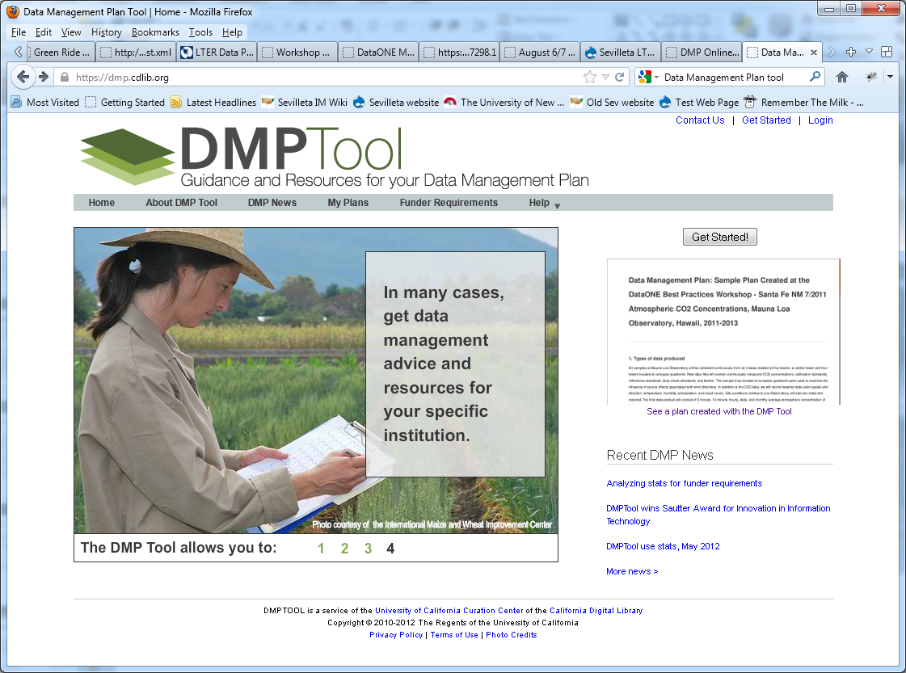
http://dmp.cdlib.org

Slide 29
What a researcher can do
View sample plans
Preview funder requirements
Create, save, edit, publish plan
View and use past plans
User help (generic and institution specific)
View news and latest changes

Slide 30
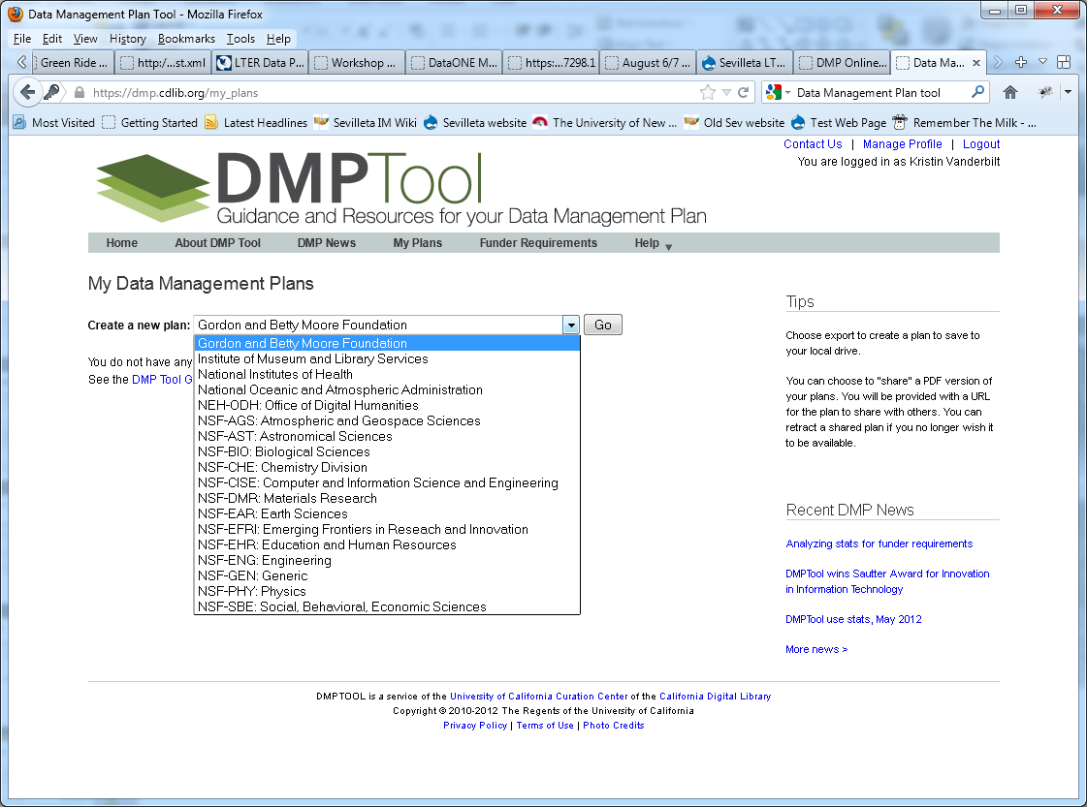

Slide 31
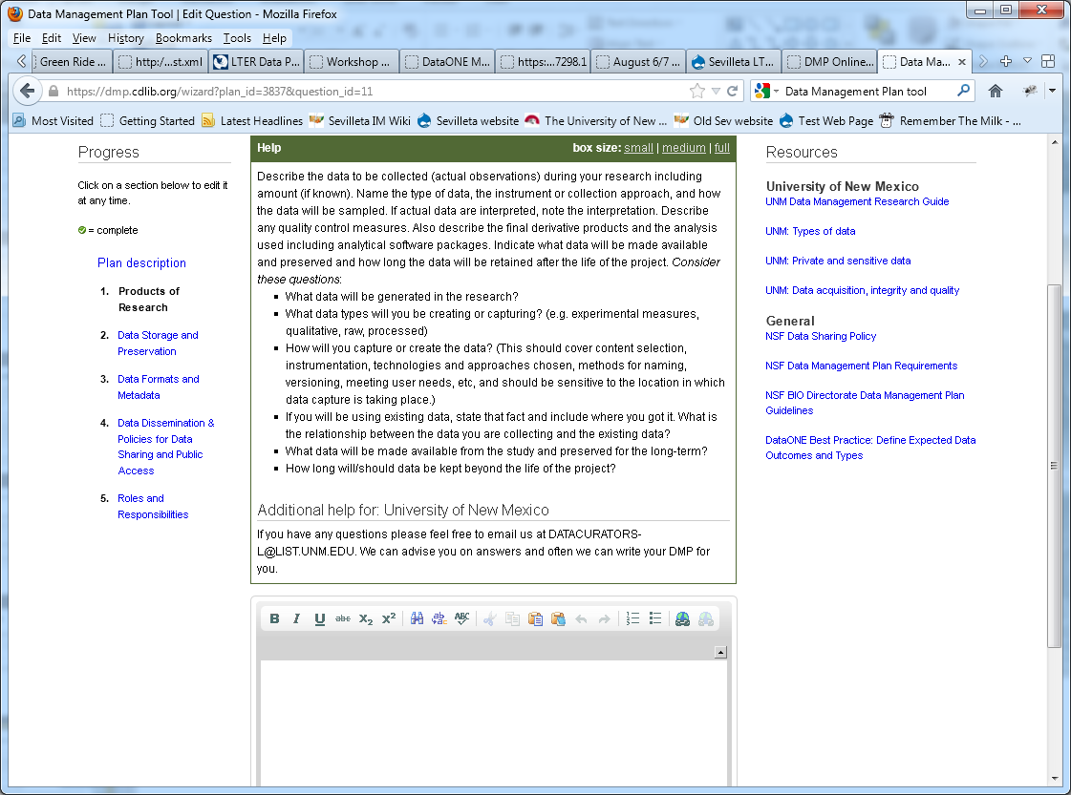

Slide 32
Summary
DMPs are an important part of the data life cycle. They save time and effort in the long run, and ensure that data are relevant and useful for others.
Funding agencies are beginning to require DMPs
Major components of a DMP:
Information about data & data format
Metadata content and format
Policies for access, sharing and re-use
Long-term storage and data management
Budget
Data Management Plans

Slide 33
Resources
University of Virginia Library http://www2.lib.virginia.edu/brown/data/plan.html
Digital Curation Centre http://www.dcc.ac.uk/resources/data-management-plans
University of Michigan Library http://www.lib.umich.edu/research-data-management-and-publishing-support/nsf-data-management-plans#directorate_guide
NSF Grant Proposal Guidelines http://www.nsf.gov/pubs/policydocs/pappguide/nsf11001/gpg_2.jsp#dmp
Inter-University Consortium for Political and Social Research http://www.icpsr.umich.edu/icpsrweb/ICPSR/dmp/index.jsp
DataONE http://www.dataone.org/plans
Data Management Plans

